Slide 1
A Review of the Impact of Obstetric Anesthesia on Maternal and Neonatal Outcomes
R2 สุพฤกษ์ /อ.นวลวรรณ

Slide 2


Slide 3
Outline
Labor Analgesia and Anesthesia
Anesthesia for Cesarean Delivery
Maternal Safety

Slide 4
Labor Analgesia and Anesthesia

Slide 5
Neuraxial analgesia
Methods:
- Epidural analgesia
- Combined spinal-epidural analgesia
CSE has faster onset (2 to 5 min) than epidural analgesia (15 to 20 min), greater uniformity in sensory blockade and improved sacral dermatome coverage

Slide 6
Neuraxial analgesia
A 2014 meta-analysis did not find a definitive benefit of combined spinal-epidural analgesia for catheter replacement rates, supplemental epidural dosing, and epidural vein cannulation
Higher risk of uterine tachysystole after combined spinal-epidural analgesia than epidural analgesia has been reported

Slide 7
Neuraxial analgesia
A modification of the combined spinal-epidural techniqueis Dural puncture epidural analgesia
  The epidural space is identified and the dura is punctured with a 25-gauge or smaller pencil-point spinal needle,
  no intrathecal medication is injected
  an epidural catheter is threaded in the routine manner

Slide 8
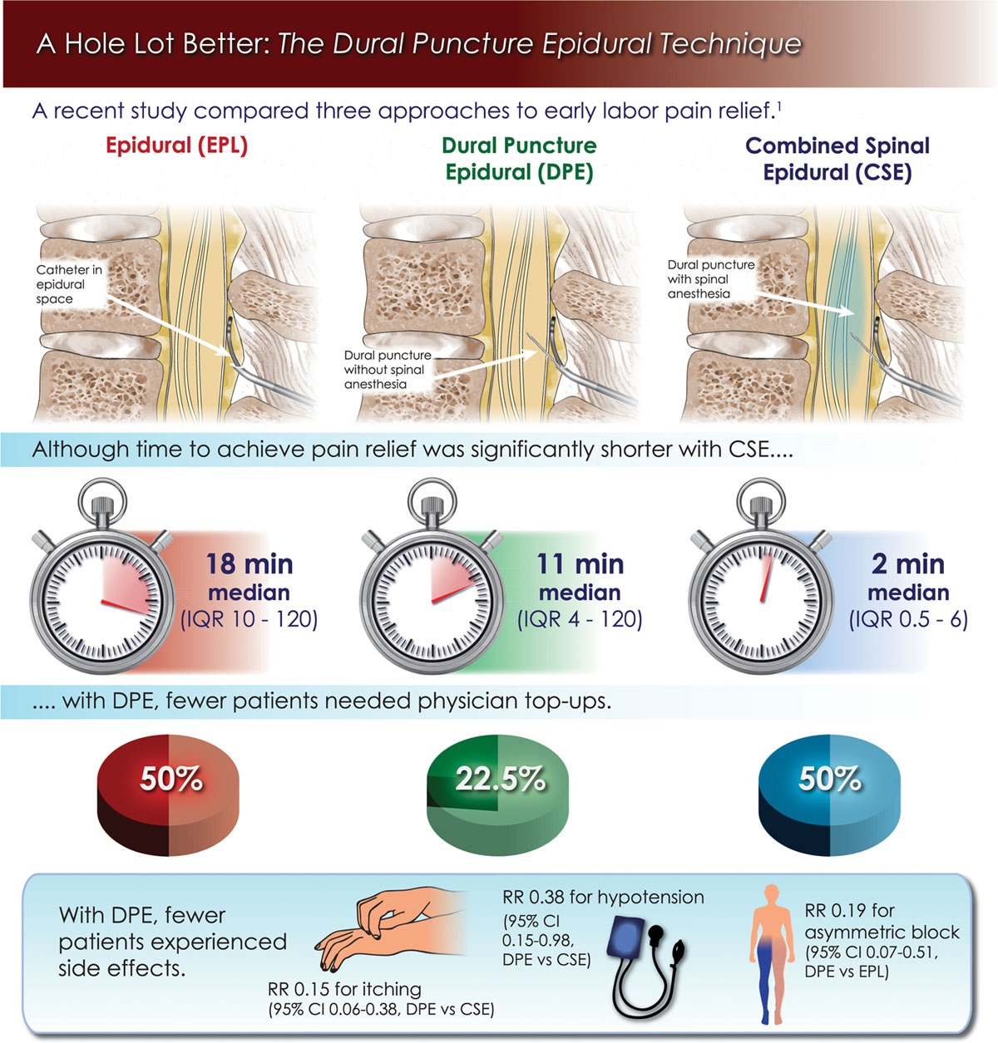

Slide 9
Neuraxial analgesia
Dural puncture epidural analgesia
Improved sacral analgesia compared to epidural analgesia,
less pruritus, hypotension, supplemental epidural doses, and uterine tachysystole than combined spinal-epidural analgesia
Notes:
A likely mechanism is the dural hole acts as a conduit to enhance epidural medication translocation into the intrathecal space, allowing enhanced coverage of sacral nerve roots while avoiding the side effects associated with conventional combined spinal-epidural analgesia.
Dural puncture epidural analgesia may be a viable technique for patients with a suspected difficult airway or failed epidural labor analgesia, for whom confirmation of correct epidural needle placement is critical, without incurring the side
effects of spinal medication dosing.

Slide 10
Neuraaxial analgesia
Modern labor analgesia favors initiation and maintenance of analgesia with low-dose local anesthesia and opioid to minimize risks of
  local anesthetic systemic toxicity
  high- or total-spinal anesthesia
  hemodynamic effects
  placental drug transfer

Slide 11
Neuraxial analgesia
Initiation of epidural analgesia combines low-dose, long-acting amide local anesthetics
typically a bolus of 5 to 15 ml bupivacaine 0.0625% to 0.125%
lipid soluble opioid typically fentanyl 50 to 100 μg or sufentanil 5 to 10 μg

Slide 12
Neuraxial analgesia
Initiation of combined spinal-epidural analgesia may vary based on the stage of labor
An opioid-only intrathecal dose (e.g., fentanyl 25 μg) is highly effective in the first stage of labor
Notes:
although it is accompanied by a high incidence of pruritus

Slide 13
Neuraxial analgesia
A combination of intrathecal local anesthetic and lipid soluble opioid (e.g., bupivacaine 1.25 to 2.5 mg and fentanyl 15 μg) effectively treats somatic pain of the late first and second stages of labor
Notes:
although it is accompanied by a high incidence of pruritus

Slide 14
Continuous Epidural Infusion vs Programed Intermittent Bolus
Analgesia is superior when patient-controlled epidural analgesia(PCEA) is used with a background infusion compared to without an infusion
PCEA is preferable to fixed-rate continuous epidural infusion
  lower total local anesthetic dose consumption
  lower incidence of motor blockade
  reduced need for anesthesia provider interventions
Notes:
Prior to the advent of infusion pump technology, maintenance of labor analgesia occurred by manual intermittent boluses throughout labor A major disadvantage of this maintenance strategy was that analgesiawould eventually regress, leading to recurrence of pain,requiring another manual bolus; thus, analgesia was episodic

Slide 15
Continuous Epidural Infusion vs Programed Intermittent Bolus
Settings for PCEA are variable
Background infusion of bupivacaine 0.05% to 0.1% with fentanyl 1.5 to 3 μg/ml or sufentanil 0.2 to 0.33 μg/ml at 5 to 8 ml/h
Bolus of 5 to 10ml, and a lockout interval of 10 to 20 min

Slide 16
Continuous Epidural Infusion vs Programed Intermittent Bolus
Programed intermittent epidural bolus has been recently investigated
It is administered by the infusion pump programed to deliver boluses of epidural solution at regular intervals

Slide 17
Continuous Epidural Infusion vs Programed Intermittent Bolus
Greater medication spread in the epidural space

Slide 18
Continuous Epidural Infusion vs Programed Intermittent Bolus
Programed intermittent epidural bolus
  Less local anesthetic doses
  Higher satisfaction scores
  Fewer supplemental epidural doses (less breakthrough pain)
  Reduced risk for motor block (odds ratio 21.2, P < 0.001)
  reduced risk for instrumented delivery (20% vs. 7%, P = 0.03)

Slide 19
Continuous Epidural Infusion vs Programed Intermittent Bolus
Programed intermittent epidural bolus
  Disadvantage is unintentional high neuroblockade (catheter migration into the intrathecal space)
  The focus of current research is identifying optimal settings for epidural bolus volume and interval, bolus infusion rate, and local anesthetic concentration

Slide 20
Systemic Opioids for Labor Analgesia
Alternative option
Fentanyl patient-controlled intravenous analgesia, 25 μg every 10 to 15 min with an hourly lockout of 100 μg
Notes:
Systemic opioids are an alternative option for women for whom neuraxial analgesia may be contraindicated, cannot be achieved (technical failure to place an epidural catheter), or who prefer an alternative method of labor analgesia

Slide 21
Systemic Opioids for Labor Analgesia
Remifentanil patient-controlled intravenous analgesia
rapidly metabolized by plasma esterases
  reduced fetal placental transfer
  rapid fetal clearance of drug

Slide 22
Systemic Opioids for Labor Analgesia
Timing the self-administered bolus dose with the peak of uterine contractions is difficult
The peak analgesic effect occurs with the second contraction after the button is pushed
Risk for maternal oxygen desaturation was significantly higher in women receiving remifentanil compared to fentanyl

Slide 23
Systemic Opioids for Labor Analgesia
Remifentanil patient-controlled intravenous analgesia is not superior to neuraxial labor analgesia
However, one randomized trial noted that while pain scores reductions were greater with neuraxial analgesia, patient satisfaction scores were not different

Slide 24

Nitrous Oxide
Nitrous oxide for labor analgesia has a long history of safe maternal use
Several studies have reported no adverse neonatal events of this nature after maternal exposure to nitrous oxide for labor

Slide 25
Nitrous Oxide
Improved maternal satisfaction and coping compared to no analgesia
Analgesic efficacy exhibits high inter-individual variability
Increasing women’s choices for labor analgesia
Notes:
although its analgesic efficacy is inferior toneuraxial labor analgesia

Slide 26
Effect of Labor Analgesia on Labor Progress and Mode of Delivery
Risk for Instrumental Delivery
Meta-analyses of randomized trials comparing labor neuraxial analgesia to systemic opioids
First and Second stages of labor were prolonged in neuraxial analgesia groups by 30 min and 15 min, respectively
Rate of instrumental vaginal delivery was increased( relative risk 1.42; 95% CI, 1.28 to 1.57)

Slide 27
Effect of Labor Analgesia on Labor Progress and Mode of Delivery
Risk for Instrumental Delivery
many of the trials that were included in the meta-analyses used epidural bupivacaine concentrations of 0.25%
Notes:
This concentration is considered high, by modern standards.

Slide 28
Effect of Labor Analgesia on Labor Progress and Mode of Delivery
Risk for Instrumental Delivery
A meta-analysis of 11 randomized trials compared the instrumental delivery rate in high- versus low-concentration local anesthetic solution groups
Low-concentration strategies were linked to reduced risk for assisted vaginal delivery and motor block

Slide 29
Effect of Labor Analgesia on Labor Progress and Mode of Delivery
Risk for Instrumental Delivery
The goal of modern labor epidural analgesia favors minimizing motor blockade by using low-concentration local anesthetic solutions

Slide 30
Effect of Labor Analgesia on Labor Progress and Mode of Delivery
Mode of delivery
“Early” labor epidural analgesia was historically believed to be a risk factor for cesarean delivery
Multiple randomized control trials comparing early to later initiation of labor neuraxial analgesia failed to find a link between early use and risk for cesarean delivery
Notes:
(i.e., epidural analgesia performed during the latent phase of labor)

Slide 31
Effect of Labor Analgesia on Labor Progress and Mode of Delivery
Mode of delivery
A 2011 systematic review of 38 randomized trials did not identify a link between labor epidural analgesia and risk for cesarean delivery
The practice of avoiding neuraxial labor analgesia in early labor for fear that it will adversely affect the mode of delivery should be completely abandoned.

Slide 32
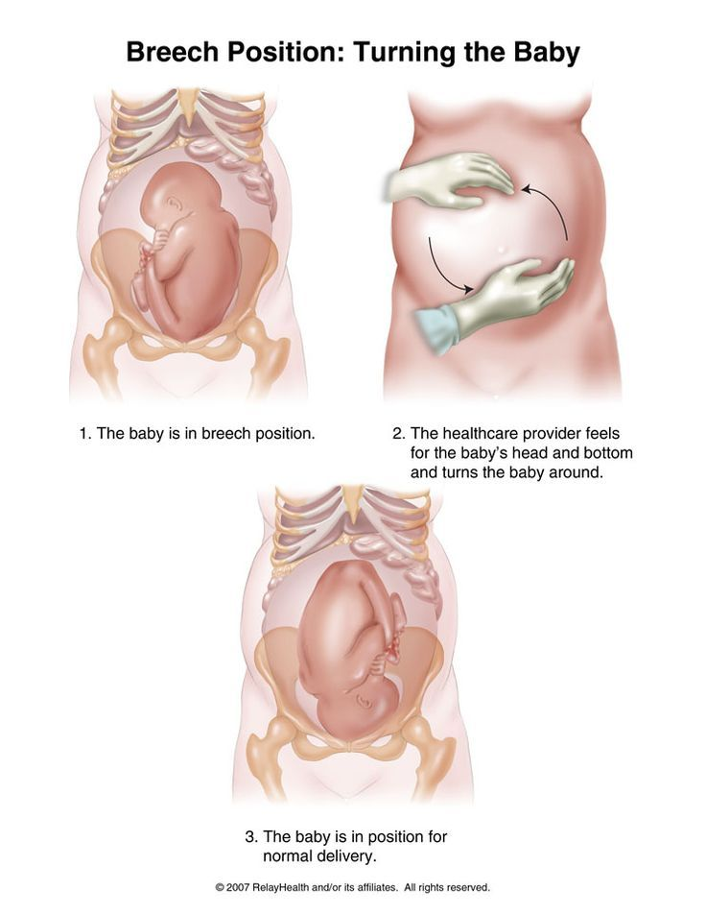
Neuraxial Anesthesia for External Cephalic Version
Neuraxial anesthesia for attempted external cephalic version is associated with a higher success rate

Slide 33
Neuraxial Anesthesia for External Cephalic Version
Advantage
  ability to convert to surgical anesthesia in the event of emergency cesarean delivery
Disadvantage
  hypotension and
  delayed hospital discharge
Notes:
although its analgesic efficacy is inferior toneuraxial labor analgesia

Slide 34
Oral intake in Labor
Aspiration was a leading cause of anesthesia related maternal mortality
Widespread use of neuraxial anesthesia
Oral intake restrictions during labor
Preanesthetic antacid administration
Rapid-sequence induction for general anesthesia
Improvements in anesthesia training
Improvements in advanced airway devices
Notes:
although its analgesic efficacy is inferior toneuraxial labor analgesia

Slide 35
Oral intake in Labor
Current American Society of Anesthesiologists guidelines
  allow clear liquid intake in uncomplicated labor and complete avoidance of particulate and solid food
Notes:
although its analgesic efficacy is inferior toneuraxial labor analgesia

Slide 36
Anesthesia for Cesarean Delivery

Slide 37
Advances in Spinal Anesthesia for Cesarean Delivery
Single-shot spinal anesthesia is the most common technique
  Simplicity
  Quality of sensory blockade
  Reliability

Slide 38
Advances in Spinal Anesthesia for Cesarean Delivery
The effective dose for hyperbaric bupivacaine in 95% of patients is 13 mg with intrathecal fentanyl and morphine
Higher doses (e.g., 15 mg) are associated with longer duration, but also with higher sensory blockade to cervical dermatomes and hypotension

Slide 39
Advances in Spinal Anesthesia for Cesarean Delivery
Adding morphine confers postoperative analgesia of up to 36 h
Epinephrine (0.1 to 0.2 mg), producing a 15% increase in block duration and improving the quality of intraoperative analgesia
Clonidine improves intraoperative analgesia and reduces shivering and hyperalgesia, but is associated with hypotension and sedation

Slide 40
Conversion of Epidural Analgesia to Surgical Anesthesia
Epidural analgesia is converted to surgical anesthesia by administering high-concentration local anesthetic
15-20 ml 2% lidocainewith epinephrine 1:200,000
addition of 8.4% sodium bicarbonate alkalinizes the local anesthetic solution, which hastens onset of action
Notes:
(1 ml
for every 10 ml local anesthetic solution)

Slide 41
Conversion of Epidural Analgesia to Surgical Anesthesia
15- 20 ml 2-chloroprocaine, 3% may be used for urgent deliveries because of its shorter latency

Slide 42
Conversion of Epidural Analgesia to Surgical Anesthesia
risk factors for failed conversion
  Delivery urgency
  Supplemental analgesia during labor
  Initiation by epidural rather than CSE
  Anesthesia by generalist compared with obstetric anesthesiologists

Slide 43
Intraoperative Hypotension: The Ideal Vasopressor for
Cesarean Delivery
The ideal vasopressor to maintain uterine perfusion has been
an area of intense research for several decades
The first human trials comparing phenylephrine and ephedrine were conducted in the late twentieth century

Slide 44
Intraoperative Hypotension: The Ideal Vasopressor for
Cesarean Delivery
Neonatal outcomes (umbilical artery pH, base excess) were better in phenylephrine group
incidence of nausea and vomiting is lower with phenylephrine
Maternal bradycardia occurred with phenylephrine, patients were asymptomatic and no adverse events were noted
the efficacy and safety of phenylephrine make it superior for systemic vascular resistance restoration

Slide 45
Intraoperative Hypotension: The Ideal Vasopressor for
Cesarean Delivery
Prophylactic phenylephrine infusions are effective in preventing hypotension and require fewer anesthesia provider interventions
The usual dose range is 25 to 100 μg/min
Notes:
(vs. intermittent boluses)

Slide 46
Intraoperative Hypotension: The Ideal Vasopressor for
Cesarean Delivery
For preeclamptic patients undergoing cesarean delivery
Fetal outcomes are not influenced by choice of phenylephrine or ephedrine

Slide 47
Intraoperative Hypotension: The Ideal Vasopressor for
Cesarean Delivery
Several investigators suggest norepinephrine has characteristics
of the “ideal” vasopressor
Norepinephrine
  lower umbilical artery and vein plasma catecholamine concentration
  higher umbilical venous pH and oxygen content,
potentially indicating higher uteroplacental oxygen deliveryoxygen delivery
Notes:
the absolute differences were small

Slide 48
Intraoperative Hypotension: The Ideal Vasopressor for
Cesarean Delivery
Neonatal outcomes (umbilical artery pH, base excess) were better in phenylephrine group
incidence of nausea and vomiting is lower with phenylephrine
Maternal bradycardia occurred with phenylephrine, patients were asymptomatic and no adverse events were noted
Notes:
although its analgesic efficacy is inferior toneuraxial labor analgesia

Slide 49

Supplemental Oxygen
Supplemental oxygen is often routinely applied during cesarean delivery
A meta-analysis of 11 trials of supplemental oxygen found no benefit for maternal desaturation and neonatal Apgar scores
Notes:
although its analgesic efficacy is inferior toneuraxial labor analgesia

Slide 50
Supplemental Oxygen
The available evidence suggests that
  Routine supplemental oxygen for scheduled healthy cesarean deliveries with neuraxial anesthesia is not beneficial and its elimination may improve patient comfort
Notes:
although its analgesic efficacy is inferior toneuraxial labor analgesia

Slide 51
Postcesarean Delivery Pain and Analgesia
Multimodal analgesia is the gold standard for postcesarean delivery analgesia
Neuraxial morphine is the most effective component
  easy to administer
  inexpensive
  superior and prolonged analgesia

Slide 52
Postcesarean Delivery Pain and Analgesia
High-dose intrathecal morphine (more than 100 μg) has longer-lasting analgesia (4.5 h) compared with low-dose morphine (50 to 100 μg),
but is associated with a higher rate of pruritus and vomiting

Slide 53
Postcesarean Delivery Pain and Analgesia
NSAIDs
spares opioids use by up to 50%
30% reduction of opioid-related side effects such as vomiting and sedation

Slide 54
Postcesarean Delivery Pain and Analgesia
Ketorolac
  The excretion of in breast milk is minimal
  usually compatible with breastfeeding
Notes:
Given the safety profile of ketorolac is unlikely to be different from ibuprofen

Slide 55
Postcesarean Delivery Pain and Analgesia
Acetaminophen
opioid-sparing effects by up to 20% and has an additive effect when administered concomitantly with NSAID
Notes:
Given the safety profile of ketorolac is unlikely to be different from ibuprofen

Slide 56
Peripheral Nerve Blocks for Postcesarean Delivery Analgesia
For Pfannenstiel and low-transverse incisional pain
  Transversus abdominis plane
  Quadratus lumborum, and
  Ilioinguinal-iliohypogastric blocks
  Continuous wound infiltration

Slide 57
Peripheral Nerve Blocks for Postcesarean Delivery Analgesia
Transversus abdominis plane block is not superior to intrathecal morphine for postcesarean delivery analgesia
Notes:
In a comparison of intrathecal morphine combined with ropivacaine transversus abdominis plane block to intrathecal morphine combined with a sham block, there were no differences in pain with movement at 24 h, and no differences insupplemental opioid dose.151////////
(e.g., cesarean delivery with general anesthesia, contraindications to neuraxial morphine)
The likely explanation for these findings is that transversus abdominis plane block is useful for treating incisional pain, but not visceral pain. A transversus abdominis plane block may be helpful for “rescue” analgesia for breakthrough

Slide 58
Peripheral Nerve Blocks for Postcesarean Delivery Analgesia
The addition of transversus abdominis plane block to the gold standard (multimodal analgesia) is not routinely necessary for effective postcesarean delivery analgesia
But transversus abdominis plane block may be useful when neuraxial morphine is not part of the pain management strategy

Slide 59
Peripheral Nerve Blocks for Postcesarean Delivery Analgesia
A quadratus lumborum block may have advantages over the transversus abdominis plane block because of its more superficial location
It involves deposition of local anesthetic into the fascial plane located between the quadratus lumborum and erector spinae muscles
this space is continuous with the paravertebral space, thus enhancing medication spread to the include the sympathetic chain

Slide 60
Peripheral Nerve Blocks for Postcesarean Delivery Analgesia
In two randomized trials, quadratus lumborum block combined with spinal anesthesia was found to be superior to spinal anesthesia alone, and to transversus abdominis plane block with spinal anesthesia
A major limitation of these trials was the absence of comparison to intrathecal morphine

Slide 61
Peripheral Nerve Blocks for Postcesarean Delivery Analgesia
Local anesthetic wound infiltration may be beneficial if cesarean delivery is performed under general anesthesia, but not under spinal anesthesia
Continuous wound infiltration improves pain on movement and reduces opioid use, but high infusion rates required to achieve this benefit lead to wound leakage, and low patient and practitioner acceptability

Slide 62
Peripheral Nerve Blocks for Postcesarean Delivery Analgesia
Risk for surgical site infection is not increased

Slide 63
Peripheral Nerve Blocks for Postcesarean Delivery Analgesia
Trials comparing ilioinguinal-iliohypogastric blocks to intrathecal morphine have not shown a benefit, but these blocks may have a role in rescue analgesia

Slide 64
Peripheral Nerve Blocks for Postcesarean Delivery Analgesia
Multimodal analgesia with neuraxial morphine, NSAIDs, and acetaminophen is the gold standard for postcesarean delivery pain
Supplemental analgesia using peripheral nerve blocks may be useful in cases of breakthrough pain, or when the gold standard multimodal analgesia cannot be delivered
Notes:
(e.g., cesarean delivery under general anesthesia, contraindications to NSAID administration).

Slide 65
Obstetric Anesthesia Outcomes
Effects of Labor Analgesia on the Fetus
Fetal bradycardia is occasionally observed after initiation of neuraxial labor analgesia
incidence of fetal bradycardia was higher after combined spinal-epidural than epidural analgesia (32% vs. 6%)
Notes:
although the study was limited by nonstandardized spinal dosing and monitoring for only 15 min after injection.8

Slide 66
Obstetric Anesthesia Outcomes
Effects of Labor Analgesia on the Fetus
The mechanism of analgesia-mediated bradycardia is thought to be rapid decrease in circulating epinephrine concentration with the onset of neuraxial analgesia
Epinephrine is a tocolytic, and its acute withdrawal may contribute to uterine tachysystole, reducing placental perfusion time

Slide 67
Obstetric Anesthesia Outcomes
Effects of Labor Analgesia on the Fetus
The usual measures of in utero fetal resuscitation (change in maternal position, intravenous fluid bolus, discontinuation of exogenous oxytocin) are usually successful in restoring fetal heart rate.
Occasionally, administration of a tocolytic (nitroglycerin, terbutaline) is necessary

Slide 68
Breastfeeding
Neuraxial analgesia’s effect on breastfeeding is controversial
Factors likely more important than labor epidural analgesia include early maternal-infant bonding, skin-to-skin contact, and breastfeeding support
Breastfeeding outcomes after general versus neuraxial anesthesia for cesarean delivery are also unclear

Slide 69
Fever and Neonatal Sepsis Workup
Multiple studies support that labor epidural analgesia is linked to clinical fever
Neonatal sepsis evaluation and maternal and neonatal antibiotic exposure is significantly increased among mother-infant dyads with labor epidural-associated fever
It is not clear whether labor epidural-associated fever impacts short- or long-term adverse infant outcomes
Notes:
Study limitations
include uncontrolled factors such as obstetric management,
selection bias, crossover and dropout, and measurement
error.172 Concerningly, maternal fever in general (not
restricted to epidural-associated fever) is associated with
poor neonatal outcomes, including assisted ventilation, low
1- and 5-min Apgar scores, seizures, and hypotonia.172 These
outcomes occur more commonly in women who receive epidural
analgesia and had a fever, but not among women who
received epidural analgesia and remained afebrile.

Slide 70
Depression
Neuraxial analgesia’s effect on breastfeeding is controversial

Slide 71
Anesthesiology Contributions to Maternal Safety

Slide 72
Mortality Due to Anesthesia
Anesthesia-related maternal mortality has decreased significantly over the last half-century
often associated with complications of neuraxial anesthesia

Slide 73
Postpartum Hemorrhage and Patient Blood Management
Leading cause of maternal morbidity and mortality worldwide
Most cases of hemorrhage-related maternal mortality are preventable

Slide 74
Postpartum Hemorrhage and Patient Blood Management
Severe obstetric hemorrhage is more likely to be associated with early hypofibrinogenemia
levels less than200 mg/dl should prompt aggressive monitoring and treatment
Notes:
The American Society of Anesthesiologists guidelines specify that fibrinogen levels should be treated early in obstetric hemorrhage.192

Slide 75
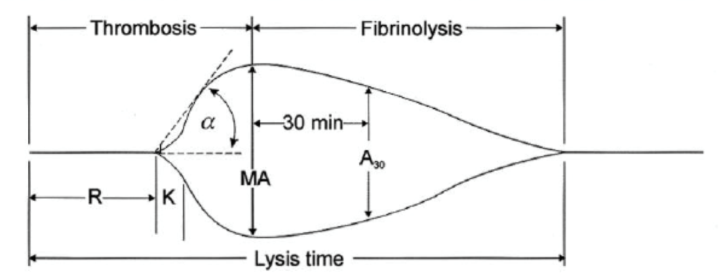
Postpartum Hemorrhage and Patient Blood Management
Viscoelastic tests (thromboelastography) may be useful in assessing clot strength and thrombin generation
Notes:
However, in major obstetric hemorrhage, laboratory testing performed better at detecting large aberrations in coagulation values, which correlated better with estimated blood loss, than thromboelastography

Slide 76
Postpartum Hemorrhage and Patient Blood Management
Antifibrinolytic agents(tranexamic acid)
Prophylactic use in planned cesarean deliveries leads to clinically insignificant bleeding differences

Slide 77
Postpartum Hemorrhage and Patient Blood Management
In 2017, World Maternal Antifibrinolytic Trial
tranexamic acid versus placebo in 20,060 women with a clinical diagnosis of postpartum hemorrhage
Death due to hemorrhage was significantly reduced in women who received tranexamic acid (1.5% vs. 1.9%; risk ratio, 0.81; 95% CI, 0.65 to 1.00; P = 0.045)
Notes:
198 hospitals in 21 countries were included, primarily low-resource settings with high rates of maternal hemorrhage deaths

Slide 78
Postpartum Hemorrhage and Patient Blood Management
Laparotomy to control bleeding was reduced (risk ratio 0.64; 95% CI, 0.49 to 0.85; P = 0.002)
Beneficial regardless of cause of hemorrhage (e.g., trauma, atony)
The risk of hysterectomy and thromboembolic events were not different
Tranexamic acid should be given as soon as possible in postpartum hemorrhage

Slide 79
Oxytocin Protocols
Active management of the third stage of labor reduces postpartum hemorrhage risk
Prophylactic uterotonic agents (oxytocin) + controlled umbilical cord traction
Oxytocin is often given as an infusion due to its short half-life of 1 to 5 min

Slide 80
Oxytocin Protocols
George et al. estimated that the oxytocin infusion ED90 for satisfactory uterine tone in women undergoing elective cesarean delivery is 0.3 units/ min (18 units/h)

Slide 81
Oxytocin Protocols
Oxytocin receptor desensitization
giving more oxytocin in desensitization may not achieve the desired effect of increased uterine tone
A different uterotonic agent is indicated

Slide 82


